Slide 1
Write your own 1D-FDTD code with python
Continued

Slide 2


Slide 3
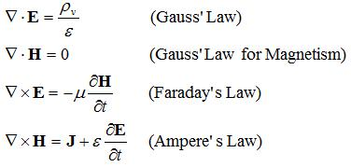
What is FDTD
Finite Difference Time Domain
Solves Maxwell’s equations using finite differences

Slide 4
What is FDTD
Finite Difference Time Domain
Solves Maxwell’s equations using finite differences
Describe time dynamics

Slide 5
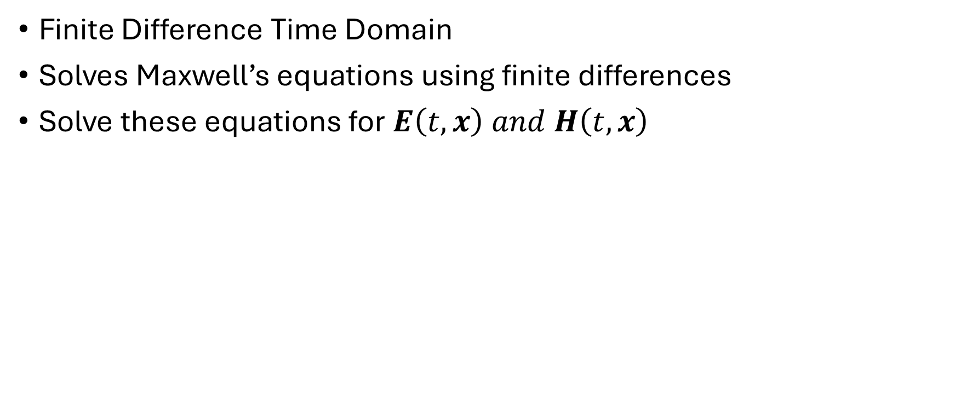
What is FDTD
Finite Difference Time Domain
Solves Maxwell’s equations using finite differences
Solve these equations for $E\left(t,x\right) and H\left(t,x\right)$
Describe time dynamics

Slide 6
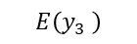
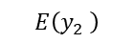
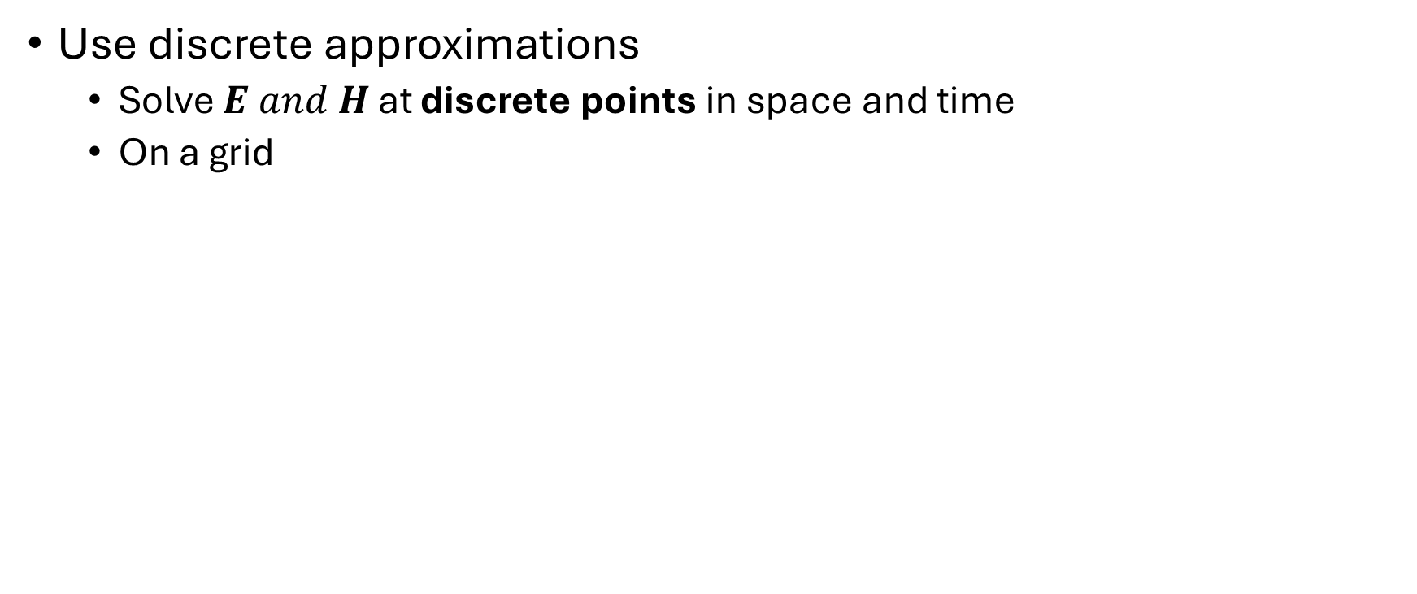
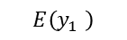
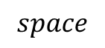
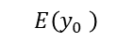
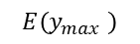
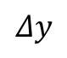
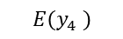
What is FDTD
Use discrete approximations
Solve $E and H$ at discrete points in space and time
On a grid
$$E\left(y_{0} \right)$$
$$E\left(y_{2} \right)$$
$$E\left(y_{4} \right)$$
…
…
$$Δy$$
$$E\left(y_{max} \right)$$
$$E\left(y_{1} \right)$$
$$E\left(y_{3} \right)$$
$$space$$

Slide 7
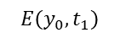
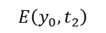
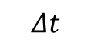
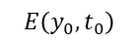
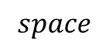
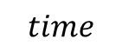
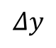
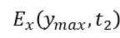
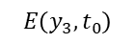
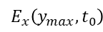
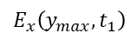
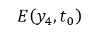
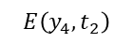
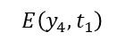
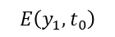
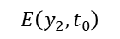
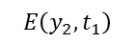
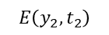
What is FDTD
…
…
$$E\left(y_{0},t_{2}\right)$$
$$E\left(y_{2},t_{2}\right)$$
$$E\left(y_{4},t_{2}\right)$$
…
…
$$E_{x}\left(y_{max},t_{2}\right)$$
$$E\left(y_{0},t_{1}\right)$$
$$E\left(y_{2},t_{1}\right)$$
$$E\left(y_{4},t_{1}\right)$$
…
…
$$E_{x}\left(y_{max},t_{1}\right)$$
$$Δt$$
$$time$$
$$E\left(y_{0},t_{0}\right)$$
$$E\left(y_{2},t_{0}\right)$$
$$E\left(y_{4},t_{0}\right)$$
…
…
$$E_{x}\left(y_{max},t_{0}\right)$$
$$E\left(y_{1},t_{0}\right)$$
$$E\left(y_{3},t_{0}\right)$$
$$Δy$$
$$space$$

Slide 8
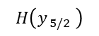
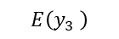
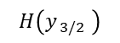
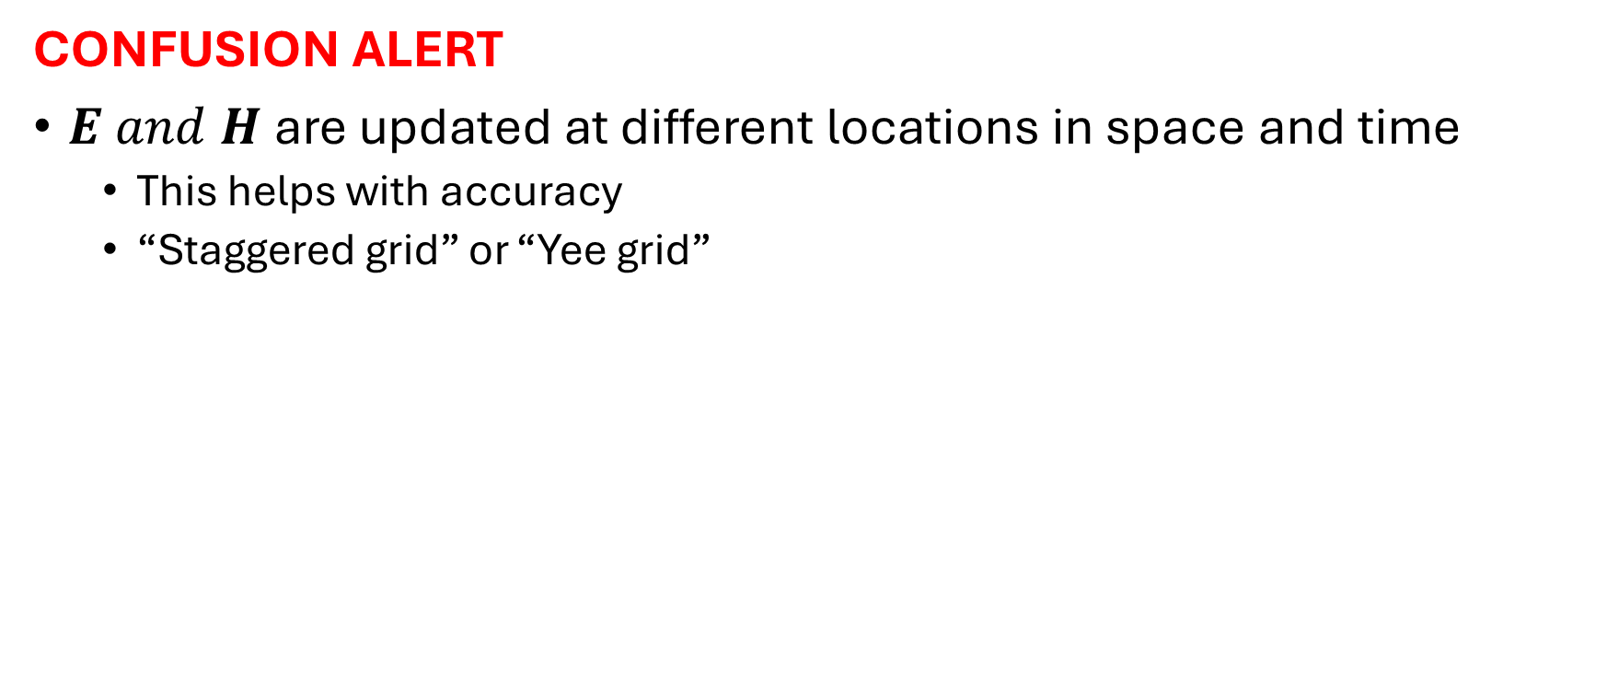
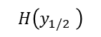
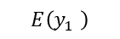
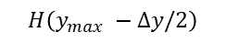
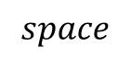
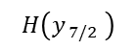
What is FDTD
CONFUSION ALERT
$E and H$ are updated at different locations in space and time
This helps with accuracy
“Staggered grid” or “Yee grid”
$$H\left(y_{ 3/2} \right)$$
$$H\left(y_{ 7/2} \right)$$
…
…
$$H\left(y_{1/2} \right)$$
$$H\left(y_{ 5/2} \right)$$
$$H\left(y_{max} −Δy/2\right)$$
$$E\left(y_{0} \right)$$
$$E\left(y_{2} \right)$$
$$E\left(y_{4} \right)$$
…
…
$$Δy$$
$$E\left(y_{max} \right)$$
$$E\left(y_{1} \right)$$
$$E\left(y_{3} \right)$$
$$space$$

Slide 9

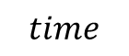
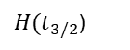
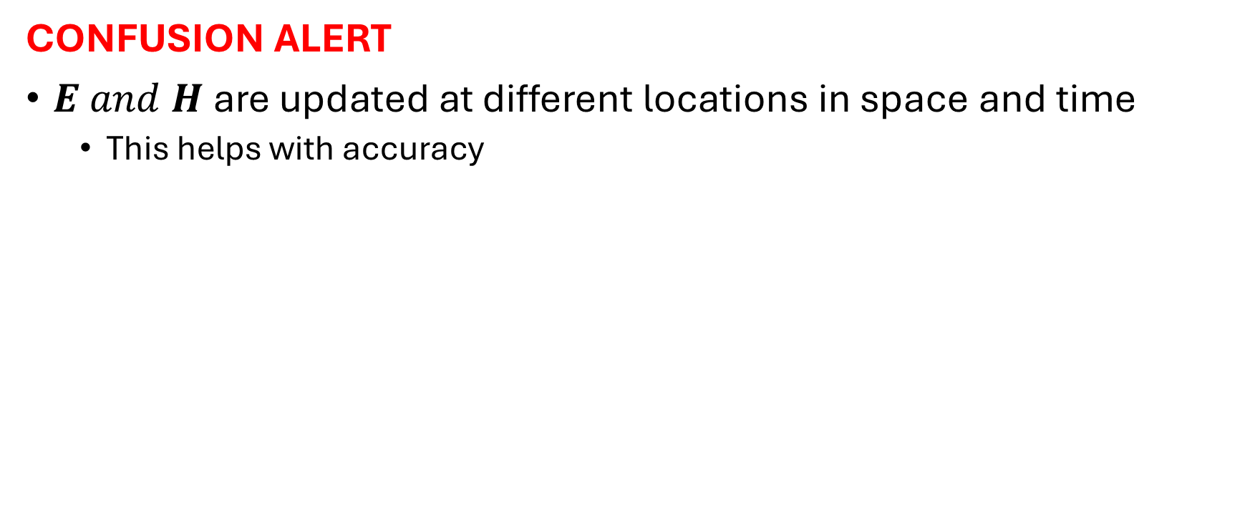

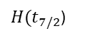
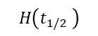
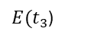
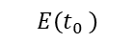
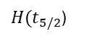
What is FDTD
CONFUSION ALERT
$E and H$ are updated at different locations in space and time
This helps with accuracy
$$H\left(t_{1/2} \right)$$
$H(t_{3/2}$)
$H(t_{5/2}$)
$H(t_{7/2}$)
…
$$time$$
$$E\left(t_{0} \right)$$
$$E\left(t_{1}\right)$$
$$E\left(t_{2}\right)$$
$E(t_{3}$)
…

Slide 10
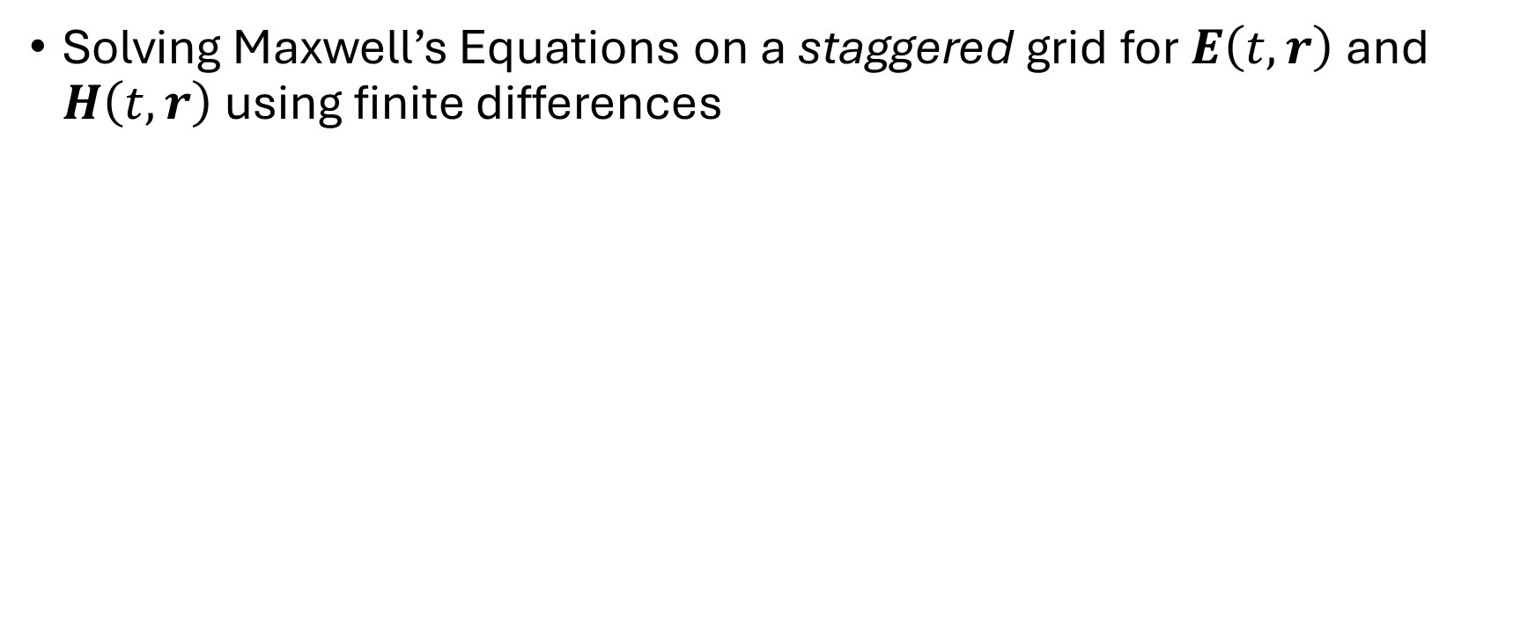
FDTD in a nutshell
Solving Maxwell’s Equations on a staggered grid for $E\left(t,r\right)$ and $H\left(t,r\right)$ using finite differences

Slide 11
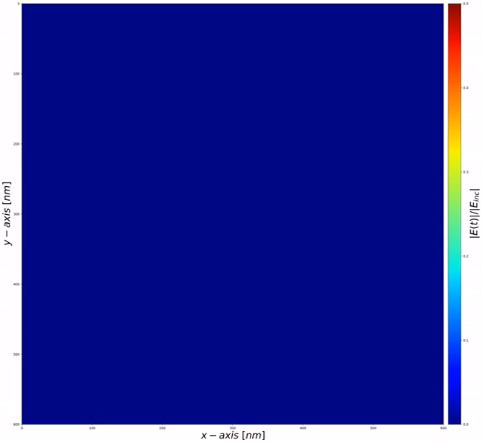

Slide 12
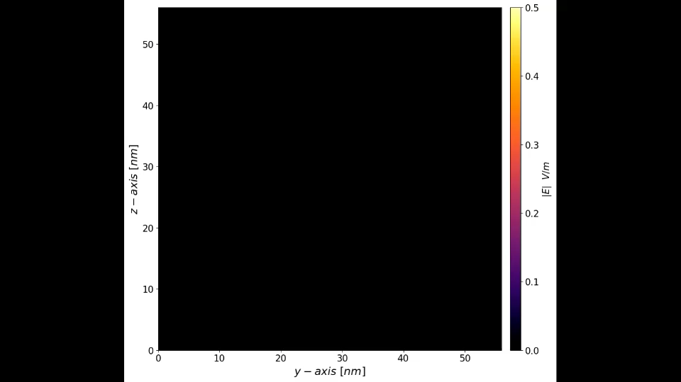

Slide 13
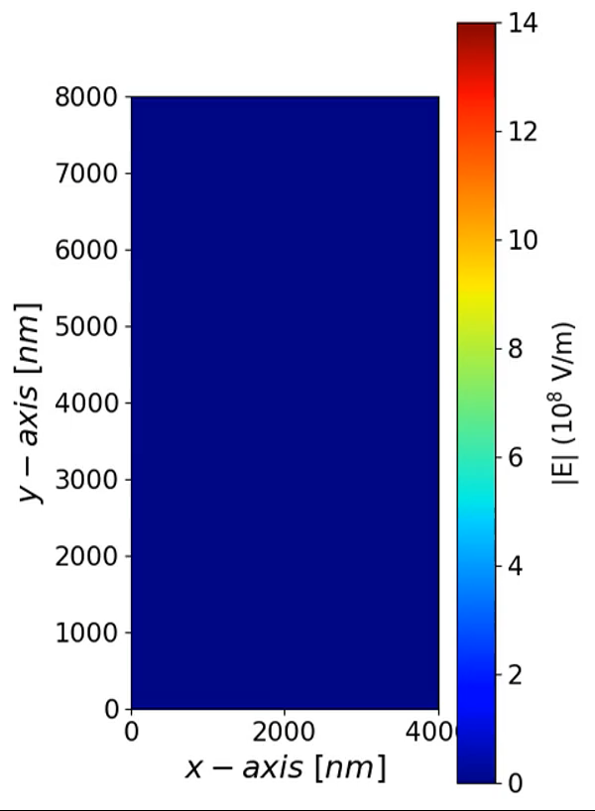

Slide 14

Maxwell’s Equations
In 1D
Assume only propagation along $y−$ direction
$$μ_{0}\frac{∂H_{z}}{∂t} =\frac{∂E_{x}}{∂y}$$
$$ε_{0}ε\frac{∂E_{x}}{∂t}=\frac{∂H_{z}}{∂y}$$

Slide 15





Finite Differences
Numerical approximation of the derivative
$$\frac{df}{dx}\left(x_{0}\right)≈\frac{f\left(x_{0}+\frac{Δx}{2}\right)−f\left(x_{0}−\frac{Δx}{2}\right)}{Δx}$$
Centered differences have higher accuracy
Results in “half-steps”
$$f\left(x_{0}−\frac{Δx}{2}\right)$$
$$f\left(x_{0}\right)$$
$$f\left(x_{0}+\frac{Δx}{2}\right)$$
$$f\left(x\right)$$
$$Δx$$
$$x$$

Slide 16

Numerical approximation of time derivative
$$\frac{∂H_{z}}{∂t}=\frac{1}{μ_{0}}\frac{∂E_{x}}{∂y}$$
$$\frac{H_{z}\left(t_{0}+\frac{Δt}{2}\right)−H_{z}\left(t_{0}−\frac{Δt}{2}\right)}{Δt}=\frac{1}{μ_{0}}\frac{∂E_{x}\left(t_{0}\right)}{∂y}$$
Need to know $H_{z}$ at “half time-steps” $\left(t±\frac{Δt}{2}\right)$

Slide 17

Numerical approximation of time derivative
$$\frac{∂E_{x}}{∂t}=\frac{1}{ε_{0}ε}\frac{∂H_{z}}{∂y}$$
$$\frac{E_{x}\left(t_{0}+Δt\right)−E_{x}\left(t_{0}\right)}{Δt}=\frac{1}{ε_{0}ε}\frac{∂H_{z}\left(t_{0}+\frac{Δt}{2}\right)}{∂y}$$
Need to know $H_{z}$ at “half time-steps” $\left(t±\frac{Δt}{2}\right)$
Need to know $E_{x}$ at “whole time-steps” $\left(t+Δt\right)$

Slide 18

Update Equations
$$H_{z}\left(t+\frac{Δt}{2}\right) =H_{z}\left(t−\frac{Δt}{2}\right)+\frac{Δt}{μ_{0}}\frac{∂E_{x}\left(t\right)}{∂y}$$
$$E_{x}\left(t+Δt\right) =E_{x}\left(t\right)+\frac{Δt}{ε_{0}ε}\frac{∂H_{z}\left(t+\frac{Δt}{2}\right)}{∂y}$$

Slide 19
Update Equations
$$H_{z}\left(t+\frac{Δt}{2}\right) =H_{z}\left(t−\frac{Δt}{2}\right)+\frac{Δt}{μ_{0}}\frac{∂E_{x}\left(t\right)}{∂y}$$
$$E_{x}\left(t+Δt\right) =E_{x}\left(t\right)+\frac{Δt}{ε_{0}ε}\frac{∂H_{z}\left(t+\frac{Δt}{2}\right)}{∂y}$$
If we know $E_{x}\left(t\right)$and $H_{z}\left(t−\frac{Δt}{2}\right)$, then we can calculate $H_{z}\left(t+\frac{Δt}{2}\right)$
If we know $E_{x}\left(t\right)$and $H_{z}\left(t+\frac{Δt}{2}\right)$, then we can calculate $E_{x}\left(t+Δt\right)$

Slide 20

Self consistent loop
Solve magnetic fields every half time-step
Solve electric fields every whole time-step
Leapfrog algorithm

Slide 21


Self consistent loop
Solve magnetic fields every half time-step
Solve electric fields every whole time-step
$$H_{z}\left(−\frac{Δt}{2}\right)=0$$
Leapfrog algorithm
$$E_{x}\left(0\right)=0$$

Slide 22

Index Notation
Since we are updating at time-steps, $t=nΔt→n$
$$t+Δt=\left(n+1\right)Δt →n+1$$
$$t+\frac{Δt}{2}=\left(n+½\right)Δt →n+½$$

Slide 23

Index Notation
$$H_{z}\left(n+½\right)=H_{z}\left(n−½\right)+\frac{Δt}{μ_{0}}\frac{∂E_{x}}{∂y}\left(n\right)$$
$$E_{x}\left(n+1\right)=E_{x}\left(n\right)+\frac{Δt}{ε_{0}ε}\frac{∂H_{z}}{∂y}\left(n+½\right)$$

Slide 24



Algorithm
set $E_{x}\left(n=0\right)=0$
set $H_{z}\left(n=−\frac{1}{2}\right)=0$
for $n=0→n_{max}:$
Update Magnetic field (n+1/2)
$$H_{z}\left(n+½\right)=H_{z}\left(n−½\right)+\frac{Δt}{μ_{0}}\frac{∂E_{x}}{∂y}\left(n\right)$$
Update Electric field (n+1)
$$E_{x}\left(n+1\right)=E_{x}\left(n\right)+\frac{Δt}{ε_{0}ε}\frac{∂H_{z}}{∂y}\left(n+½\right)$$

Slide 25
Algorithm
set $E_{x}\left(n=0\right)=0$
set $H_{z}\left(n=−\frac{1}{2}\right)=0$
for $n=0→n_{max}:$
Update Magnetic field (n+1/2)
$$H_{z}\left(n+½\right)=H_{z}\left(n−½\right)+\frac{Δt}{μ_{0}}\frac{∂E_{x}}{∂y}\left(n\right)$$
Update Electric field (n+1)
what about these?
$$E_{x}\left(n+1\right)=E_{x}\left(n\right)+\frac{Δt}{ε_{0}ε}\frac{∂H_{z}}{∂y}\left(n+½\right)$$

Slide 26


Space Derivatives
$$E_{x}\left(n+1\right)=E_{x}\left(n\right)+\frac{Δt}{ε_{0}ε}\frac{∂H_{z}}{∂y}\left(n+½\right)$$
$$\frac{∂H_{z}}{∂y}\left(y_{0}\right)≈\frac{H_{z}\left(y_{0}+\frac{Δy}{2}\right)−H_{z}\left(y_{0}−\frac{Δy}{2}\right)}{Δy}$$
Need to know $H_{z}$ at “half space steps” $\left(y±\frac{Δy}{2}\right)$

Slide 27

Space Derivatives
$$\frac{∂H_{z}}{∂y}\left(y_{0}\right)≈\frac{H_{z}\left(y_{0}+\frac{Δy}{2}\right)−H_{z}\left(y_{0}−\frac{Δy}{2}\right)}{Δy}$$
$E_{x}\left(n+1,y\right)=E_{x}\left(n,y\right)+\frac{Δt}{ε_{0}ε}\left[\frac{H_{z}\left(n+½, y+\frac{Δy}{2}\right)−H_{z}\left(n+½, y−\frac{Δy}{2}\right)}{Δy}\right]$
Need to know $H_{z}$ at “half space steps” $\left(y±\frac{Δy}{2}\right)$

Slide 28

Space Derivatives
$$H_{z}\left(n+½\right)=H_{z}\left(n−½\right)+\frac{Δt}{μ_{0}}\frac{∂E_{x}}{∂y}\left(n\right)$$
$$\frac{∂E_{x}}{∂y}\left(y_{0}+\frac{Δy}{2}\right)≈\frac{E_{x}\left(y_{0}+Δy\right)−E_{x}\left(y_{0}\right)}{Δy}$$
Need to know $H_{z}$ at “half space steps” $\left(y±\frac{Δy}{2}\right)$
Need to know $E_{x}$ at “whole space steps” $\left(y+Δy\right)$

Slide 29
Space Derivatives
$$\frac{∂E_{x}}{∂y}\left(y_{0}+\frac{Δy}{2}\right)≈\frac{E_{x}\left(y_{0}+Δy\right)−E_{x}\left(y_{0}\right)}{Δy}$$
$H_{z}\left(n+½,y+Δy/2\right)=H_{z}\left(n−½,y+Δy/2\right)+\frac{Δt}{ε_{0}ε}\left[\frac{E_{x}\left(n, y+Δy\right)−E_{x}\left(n, y\right)}{Δy}\right]$
Need to know $H_{z}$ at “half space steps” $\left(y±\frac{Δy}{2}\right)$
Need to know $E_{x}$ at “whole space steps” $\left(y+Δy\right)$

Slide 30


Index Notation
Since we are updating at space-steps, $y=jΔy→j$
$$y+Δy=\left(j+1\right)Δy →j+1$$
$$y+\frac{Δy}{2}=\left(j+½\right)Δy →j+½$$

Slide 31

Update Equations
$H_{z}\left(n+½,j+½\right)=H_{z}\left(n−½,j+½\right)+\frac{Δt}{μ_{0}}\left[\frac{E_{x}\left(n,j+1\right)−E_{x}\left(n,j\right)}{Δy}\right]$
$E_{x}\left(n+1,j\right)=E_{x}\left(n,j\right)+\frac{Δt}{ε_{0}ε}\left[\frac{H_{z}\left(n+½,j+½\right)−H_{z}\left(n−½,j−½\right)}{Δy}\right]$

Slide 32

















FDTD Simulation
1D Grid, with half-cells
$$1/2$$
$$3/2$$
$$5/2$$
$$7/2$$
$$9/2$$
$$……$$
$$j_{max}−1/2$$
$$j=0$$
$$1$$
$$2$$
$$3$$
$$4$$
$$5$$
$$……$$
$$Δy$$
$$j_{max}−1$$
$$j_{max}$$

Slide 33















Update Equations
$$H_{z}\left(n+½,j+½\right)=H_{z}\left(n−½,j+½\right)+a\left[E_{x}\left(n,j+1\right)−E_{x}\left(n,j\right)\right]$$
$$E_{x}\left(n+1,j\right)=E_{x}\left(n,j\right)+b\left[H_{z}\left(n+½,j+½\right)−H_{z}\left(n+½,j−½\right)\right]$$
$$n+1$$
$$E_{x}$$
$$n+1/2$$
$$H_{z}$$
$$n$$
$$n−1/2$$
$$time$$
$$n−1$$
$$j−1/2$$
$$j+1/2$$
$$j−1$$
$$j$$
$$j+1$$
$$space$$

Slide 34



Update Equations
$$H_{z}\left(n+½,j+½\right)=H_{z}\left(n−½,j+½\right)+a\left[E_{x}\left(n,j+1\right)−E_{x}\left(n,j\right)\right]$$
$$E_{x}\left(n+1,j\right)=E_{x}\left(n,j\right)+b\left[H_{z}\left(n+½,j+½\right)−H_{z}\left(n+½,j−½\right)\right]$$
$$n+1$$
$$H_{z}\left(j+½\right)$$
$$n+1/2$$
$$n$$
$$E_{x}\left(j\right)$$
$$E_{x}\left(j+1\right)$$
$$n−1/2$$
$$time$$
$$n−1$$
$$j−1$$
$$j$$
$$j+1$$
$$space$$

Slide 35


Update Equations
$$H_{z}\left(n+½,j+½\right)=H_{z}\left(n−½,j+½\right)+a\left[E_{x}\left(n,j+1\right)−E_{x}\left(n,j\right)\right]$$
$$E_{x}\left(n+1,j\right)=E_{x}\left(n,j\right)+b\left[H_{z}\left(n+½,j+½\right)−H_{z}\left(n+½,j−½\right)\right]$$
$$E_{x}\left(j\right)$$
$$n+1$$
$$H_{z}\left(j−½\right)$$
$$H_{z}\left(j+½\right)$$
$$n+1/2$$
$$n$$
$$E_{x}\left(j\right)$$
$$n−1/2$$
$$time$$
$$n−1$$
$$j−1$$
$$j$$
$$j+1$$
$$space$$

Slide 36

Algorithm
for all $j$set $E_{x}\left(n=0,j\right)=0$
for all $j$ set $H_{z}\left(n=−\frac{1}{2},j\right)=0$
for $n=0→n_{max}:$
Update Magnetic field (n+1/2)
for $j=0→j_{max}−1:$
$$H_{z}\left(n+½,j+½\right)=H_{z}\left(n−½,j+½\right)+a\left[E_{x}\left(n,j+1\right)−E_{x}\left(n,j\right)\right]$$
Update Electric field (n+1)
for $j=1→j_{max}−1:$
$$E_{x}\left(n+1,j\right)=E_{x}\left(n,j\right)+b\left[H_{z}\left(n+½,j+½\right)−H_{z}\left(n+½,j−½\right)\right]$$

Slide 37

Algorithm
In the actual code, we can’t use “half-step” indices
$$n+½→n$$
$$j+½→j$$
$$n−½→n−1$$
$$j−½→j−1$$

Slide 38
Algorithm
for all $j$set $E_{x}\left(n=0,j\right)=0$
for all $j$ set $H_{z}\left(n=−\frac{1}{2},j\right)=0$
for $n=0→n_{max}:$
Update Magnetic field (n+1/2)
for $j=0→j_{max}−1:$
$$H_{z}\left(n,j\right)=H_{z}\left(n−1,j\right)+\frac{Δt}{μ_{0}Δy}\left[E_{x}\left(n,j+1\right)−E_{x}\left(n,j\right)\right]$$
Update Electric field (n+1)
for $j=1→j_{max}−1:$
$$E_{x}\left(n+1,j\right)=E_{x}\left(n,j\right)+\frac{Δt}{ε_{0}ε\left(j\right)Δy}\left[H_{z}\left(n,j\right)−H_{z}\left(n,j−1\right)\right]$$

Slide 39

Step sizes and stability
Rule of thumb:
$$Δy=\min\left\{\begin{aligned}\frac{λ}{20} \\ \frac{d}{20}\end{aligned}\right.$$
- where $λ$ is the smallest wavelength of interest,
- and $d$ is the smallest feature-size of interest
For stability:
$$Δt=\frac{Δy}{c_{0}}$$
- where $c_{0}$ is the vacuum speed of light

Slide 40
CODE BREAK

Slide 41











Boundary Conditions
Currently,
$E_{x}\left(j=0\right)=E_{x}\left(j=j_{max}\right)=0$
Reflecting boundary conditions
since no field is allowed in, boundary cells act like perfect conductors
a.k.a. mirrors
$$1/2$$
$$3/2$$
$$5/2$$
$$7/2$$
$$9/2$$
$$……$$
$$j_{max}−1/2$$
$$j=0$$
$$1$$
$$2$$
$$3$$
$$4$$
$$5$$
$$……$$
$$j_{max}−1$$
$$j_{max}$$
$$Δy$$

Slide 42












Boundary Conditions
Mur Absorbing Boundary Conditions
Need for $j=0$ and $j=j_{max}$
https://home.cc.umanitoba.ca/~lovetrij/cECE7810/Papers/Mur%201981.pdf
$$1/2$$
$$3/2$$
$$5/2$$
$$7/2$$
$$9/2$$
$$……$$
$$j_{max}−1/2$$
$$j=0$$
$$1$$
$$2$$
$$3$$
$$4$$
$$5$$
$$……$$
$$j_{max}−1$$
$$j_{max}$$
$$Δy$$

Slide 43


Boundary Conditions
Mur Absorbing Boundary Conditions
For $j=0$
$E_{x}\left(n+1,0\right)=E_{x}\left(n,0\right)+a⋅\left[E_{x}\left(n+1,1\right)−E_{x}\left(n,0\right)\right]$
$$a=\frac{cΔt−Δy}{cΔt+Δy} c=\frac{c_{0}}{n_{j=0}}$$
Speed of light in vacuum
Speed of light in material
Refractive index of material (at $j=0$)

Slide 44


Boundary Conditions
Mur Absorbing Boundary Conditions
For $j=j_{max}$
$E_{x}\left(n+1,j_{max}\right)=E_{x}\left(n,j_{max}−1\right)+a′⋅[E_{x}\left(n+1, j_{max}−1\right)−E_{x}\left(n,j_{max}\right)$]
$$a′=\frac{c′Δt−Δy}{c′Δt+Δy} c=\frac{c_{0}}{n_{j=j_{max}}}$$
Speed of light in vacuum
Speed of light in material
Refractive index of material (at $j=j_{max}$)

Slide 45
Algorithm
for all $j$set $E_{x}\left(n=0,j\right)=0$
for all $j$ set $H_{z}\left(n=−\frac{1}{2},j\right)=0$
for $n=0→n_{max}:$
Update Magnetic field (n+1/2)
for $j=0→j_{max}−1:$
$$H_{z}\left(n,j\right)=H_{z}\left(n−1,j\right)+\frac{Δt}{μ_{0}Δy}\left[E_{x}\left(n,j+1\right)−E_{x}\left(n,j\right)\right]$$
Update Electric field (n+1)
for $j=1→j_{max}−1:$
$$E_{x}\left(n+1,j\right)=E_{x}\left(n,j\right)+\frac{Δt}{ε_{0}εΔy}\left[H_{z}\left(n,j\right)−H_{z}\left(n,j−1\right)\right]$$
$$E_{x}\left(n+1,0\right)=E_{x}\left(n,0\right)+a⋅\left[E_{x}\left(n+1,1\right)−E_{x}\left(n,0\right)\right]$$
$$E_{x}\left(n+1,j_{max}\right)=E_{x}\left(n,j_{max}−1\right)+a′⋅[E_{x}\left(n+1, j_{max}−1\right)−E_{x}\left(n,j_{max}\right)\text{]}$$

Slide 46


Source
Naïve source
$$E_{x}\left(n+1,j_{source}\right)=E_{x}\left(n+1,j_{source}\right)+E_{source}\left(\left(n+1\right)Δt\right)$$
$$E_{source}\left(t\right)=f_{envelope}\left(t\right)⋅sin\left(ω_{0}t\right)$$
$$1/2$$
$$3/2$$
$$5/2$$
$$7/2$$
$$9/2$$
$$……$$
$j_{source}−1/2$
$$j_{max}−1/2$$
$$j=0$$
$$1$$
$$2$$
$$3$$
$$4$$
$$5$$
$$……$$
$$j_{source}$$
$$j_{max}−1$$
$$j_{max}$$
$$Δy$$
$$E_{source}\left(t\right)$$

Slide 47

Source
Naïve source
$$E_{x}\left(n+1,j_{source}\right)=E_{x}\left(n+1,j_{source}\right)+E_{source}\left(\left(n+1\right)Δt\right)$$
$$E_{source}\left(t\right)=f_{envelope}\left(t\right)⋅sin\left(ω_{0}t\right)$$
$$1/2$$
$$3/2$$
$$5/2$$
$$7/2$$
$$9/2$$
$$……$$
$j_{source}−1/2$
$$j_{max}−1/2$$
$$j=0$$
$$1$$
$$2$$
$$3$$
$$4$$
$$5$$
$$……$$
$$j_{source}$$
$$j_{max}−1$$
$$j_{max}$$
$$Δy$$
$$E_{source}\left(t\right)$$

Slide 48












Source
Unidirectional source: Total-field scattered-field (TFSF) method
$$E_{x}\left(n+1,j_{source}\right)=E_{x}\left(n+1,j_{source}\right)+E_{source}\left(\left(n+1\right)Δt\right)$$
$$H_{z}\left(n+½,j_{source}−½\right)=H_{z}\left(n+½,j_{source}−½\right)−E_{source}\left(\left(n+½\right)Δt−t_{offset}\right)/Z$$
$$E_{source}\left(t\right)/Z$$
$$1/2$$
$$3/2$$
$$5/2$$
$$7/2$$
$$9/2$$
$$……$$
$j_{source}−1/2$
$$j_{max}−1/2$$
$$j=0$$
$$1$$
$$2$$
$$3$$
$$4$$
$$5$$
$$……$$
$$j_{source}$$
$$j_{max}−1$$
$$j_{max}$$
$$Δy$$
$$E_{source}\left(t\right)$$

Slide 49


Source
Unidirectional source: Total-field scattered-field (TFSF) method
$$E_{x}\left(n+1,j_{source}\right)=E_{x}\left(n+1,j_{source}\right)+E_{source}\left(\left(n+1\right)Δt\right)$$
$$H_{z}\left(n+½,j_{source}−½\right)=H_{z}\left(n+½,j_{source}−½\right)−E_{source}\left(\left(n+½\right)Δt−t_{offset}\right)/Z$$
Refractive index
at source
$$t_{offset}=\frac{n\left(j_{source}\right)Δy}{2c_{0}}$$
$$Z=\frac{Z_{0}}{n\left(j_{source}\right)}$$
Time to trave al ½ FDTD cell
Vacuum impedance
Impedance of material at $j_{source}$

Slide 50
Source
Unidirectional source: Total-field scattered-field (TFSF) method
$$E_{x}\left(n+1,j_{source}\right)=E_{x}\left(n+1,j_{source}\right)+E_{source}\left(\left(n+1\right)Δt\right)$$
$$H_{z}\left(n+½,j_{source}−½\right)=H_{z}\left(n+½,j_{source}−½\right)−E_{source}\left(\left(n+½\right)Δt−t_{offset}\right)/Z$$
Field scatters from object
Field injected forward
Only scattered field
on this side
This side is total field
(source and scattered)
$$j_{source}$$

Slide 51


Algorithm
for all $j$set $E_{x}\left(n=0,j\right)=0$
for all $j$ set $H_{z}\left(n=−\frac{1}{2},j\right)=0$
for $n=0→n_{max}:$
Update Magnetic field (n+1/2)
for $j=0→j_{max}−1:$
$$H_{z}\left(n,j\right)=H_{z}\left(n−1,j\right)+\frac{Δt}{μ_{0}Δy}\left[E_{x}\left(n,j+1\right)−E_{x}\left(n,j\right)\right]$$
Magnetic field Source
$$H_{z}\left(n,j_{source}−1\right)=H_{z}\left(n,j_{source}−1\right)−E_{source}\left(\left(n+½\right)Δt−t_{offset}\right)/Z$$
Update Electric field (n+1)
for $j=1→j_{max}−1:$
$$E_{x}\left(n+1,j\right)=E_{x}\left(n,j\right)+\frac{Δt}{ε_{0}εΔy}\left[H_{z}\left(n,j\right)−H_{z}\left(n,j−1\right)\right]$$
Electric field Source
$$E_{x}\left(n+1,j_{source}\right)=E_{x}\left(n+1,j_{source}\right)+E_{source}\left(\left(n+1\right)Δt\right)$$
Boundary Conditions
$$E_{x}\left(n+1,0\right)=E_{x}\left(n,0\right)+a⋅\left[E_{x}\left(n+1,1\right)−E_{x}\left(n,0\right)\right]$$
$$E_{x}\left(n+1,j_{max}\right)=E_{x}\left(n,j_{max}−1\right)+a′⋅[E_{x}\left(n+1, j_{max}−1\right)−E_{x}\left(n,j_{max}\right)\text{]}$$

Slide 52
CODE BREAK

Slide 53

Adding Material Structures
Dielectric materials
Treated as frequency-independent
$ε\left(ω\right)=const.$
Requires no change
Dispersive materials
Frequency-dependent
$ε\left(ω\right)≠const.$
Requires additional update equations

Slide 54


Adding Material Structures
Dielectric materials
Treated as frequency-independent
$ε\left(ω\right)=const.$
Requires no change
We need to set $ε\left(j\right)$
$$E_{x}\left(n+1,j\right)=E_{x}\left(n,j\right)+\frac{Δt}{ε_{0}ε\left(j\right)Δy}\left[H_{z}\left(n,j\right)−H_{z}\left(n,j−1\right)\right]$$

Slide 55
Adding Material Structures
Example: Silicon thin film
We want to know how much light is Reflected and Transmitted from a thin-film of Silicon

Slide 56



Adding Material Structures
Example: Silicon thin film
We want to know how much light is Reflected and Transmitted from a thin-film of Silicon
Thickness = $d$
$$d$$
Si
$$j_{source}$$

Slide 57



Adding Material Structures
Vacuum
Silicon
Vacuum
$$j_{source}$$
$$j_{Si_{start}}$$
$$j_{Si_{end}}$$
$$ε\left(j\right)=ε_{vac}$$
$$ε\left(j\right)=ε_{Si}$$
$$ε\left(j\right)=ε_{vac}$$

Slide 58

Adding Material Structures
Vacuum
Silicon
Vacuum
$$j_{source}$$
$$j_{Si_{start}}$$
$$j_{Si_{end}}$$
$$ε\left(j\right)=ε_{vac}=1.0$$
$$ε\left(j\right)=ε_{Si}=12.11^{∗}$$
$$ε\left(j\right)=ε_{vac}=1.0$$
*For wavelengths between 1.4 and 1.6 $μm$

Slide 59





Adding Material Structures
$ε\left(j\right)$ is centered at $j$, but occupies the region $j−\frac{1}{2}→j+\frac{1}{2}$
$$j−1/2$$
$$j+1/2$$
$$ε\left(j−1\right)$$
$$ε\left(j\right)$$
$$ε\left(j+1\right)$$

Slide 60

Adding Material Structures
$ε\left(j\right)$ is centered at $j$, but occupies the region $j−\frac{1}{2}→j+\frac{1}{2}$
Vacuum
Silicon
Vacuum
$$j_{source}$$
$$j_{Si_{start}}$$
$$j_{Si_{end}}$$
$$d=\left({j_{Si}}_{end}−{j_{Si}}_{start}+1\right)Δy$$

Slide 61


Adding Material Structures
Example: Silicon thin film
We want to know how much light is Reflected and Transmitted from a thin-film of Silicon
Need Reflection and Transmission spectrum
$$Reflection$$
$$Transmission$$
Si
$$j_{source}$$

Slide 62

Fourier Transform Monitor
Calculates frequency domain $E$ field
$E_{x}\left(t,y_{0}\right)→E_{x}\left(ω,y_{0}\right)$
Used to calculate transmittance and reflectance spectra
$T\left(ω\right), R\left(ω\right)$

Slide 63

Fourier Transform Monitor
Fourier transform
$f\left(t\right)→f\left(ω\right)$
$$f\left(ω\right)=\int_{−∞}^{+∞}{f\left(t\right)\exp\left(iωt\right)dt}$$

Slide 64

Fourier Transform Monitor
Fourier transform for FDTD
Assume all fields are 0 for $t<0$
Assume all fields are 0 for $t>t_{max}$
$$f\left(ω\right)=\int_{0}^{t_{max}}{f\left(t\right)\exp\left(iωt\right)dt}$$

Slide 65

Fourier Transform Monitor
Discrete Fourier transform for FDTD
Assume $t=nΔt$
Treat as a Reimann sum
$$f\left(ω\right)=\int_{0}^{t_{max}}{f\left(t\right)\exp\left(iωt\right)dt→\sum_{n=0}^{n_{max}}{f\left(nΔt\right)\exp\left(iωnΔt\right)Δt}}$$

Slide 66

Fourier Transform Monitor
Discrete Fourier transform for FDTD
For any point $j_{0}$, we can calculate the frequency domain electric-field
$$E_{x}\left(ω,j_{0}\right)≈\sum_{n=0}^{n_{max}}{E_{x}\left(nΔt,j_{0}\right)\exp\left(iωnΔt\right)Δt}$$

Slide 67



Calculating Transmittance and Reflectance
$$Reflection$$
$$Transmission$$
Si
$$j_{source}$$

Slide 68



Calculating Transmittance and Reflectance
Pick location for $j_{R}$ and $j_{T}$
$j_{R}:$ before $j_{source}$
$j_{T}:$ after material structure
Vacuum
Silicon
Vacuum
$$j_{R}$$
$$j_{source}$$
$$j_{Si_{start}}$$
$$j_{Si_{end}}$$
$$j_{T}$$

Slide 69
Calculating Transmittance and Reflectance
Store $E_{x}\left(j_{R},n\right)$ and $E_{x}\left(j_{T},n\right)$ for all timesteps $n$
Vacuum
Silicon
Vacuum
$$j_{R}$$
$$j_{source}$$
$$j_{Si_{start}}$$
$$j_{Si_{end}}$$
$$j_{T}$$

Slide 70

Calculating Transmittance and Reflectance
After simulation, calculate:
$$E_{x}\left(ω,j_{R}\right)≈\sum_{n=0}^{n_{max}}{E_{x}\left(n,j_{R}\right)\exp\left(iωnΔt\right)Δt}$$
$$E_{x}\left(ω,j_{T}\right)≈\sum_{n=0}^{n_{max}}{E_{x}\left(n,j_{T}\right)\exp\left(iωnΔt\right)Δt}$$
$$E_{source}\left(ω\right)≈\sum_{n=0}^{n_{max}}{E_{source}\left(n\right)\exp\left(iωnΔt\right)Δt}$$

Slide 71

Calculating Transmittance and Reflectance
After simulation, calculate:
$$R=\frac{{\left|E_{x}\left(ω,j_{R}\right)\right|}^{2}}{{\left|E_{source}\left(ω\right)\right|}^{2}}$$

Slide 72

Calculating Transmittance and Reflectance
After simulation, calculate:
$$R=\frac{{\left|E_{x}\left(ω,j_{R}\right)\right|}^{2}}{{\left|E_{0}\left(ω\right)\right|}^{2}}$$
$$T=\frac{n\left(j_{T}\right)}{n\left(j_{source}\right)}\frac{{\left|E_{x}\left(ω,j_{T}\right)\right|}^{2}}{{\left|E_{source}\left(ω\right)\right|}^{2}}$$
Refractive index at transmission point divided by Refractive index at source point

Slide 73



Algorithm
for all $j$set $E_{x}\left(n=0,j\right)=0$
for all $j$ set $H_{z}\left(n=−\frac{1}{2},j\right)=0$
for all j set $ε\left(j\right)$
for $n=0→n_{max}:$
Update Magnetic field (n+1/2)
Magnetic field Source
Update Electric field (n+1)
Electric field Source
Boundary Conditions
Store transmission/reflection fields
$$E_{R}\left(n\right)=E_{x}\left(n,j_{R}\right)$$
$$E_{T}\left(n\right)=E_{x}\left(n,j_{T}\right)$$
Post-processing:
Calculate DFTs: $E_{R}\left(ω\right),E_{T}\left(ω\right),E_{source}\left(ω\right)$
Calculate R and T

Slide 74
CODE BREAK

